Slide 1

Music Genre Classification: Understanding the Sound of AI
Exploring how artificial intelligence learns to recognize and categorize the diverse landscape of musical styles
https://music-genre-classificati-x6cefdv.gamma.site/

Slide 2

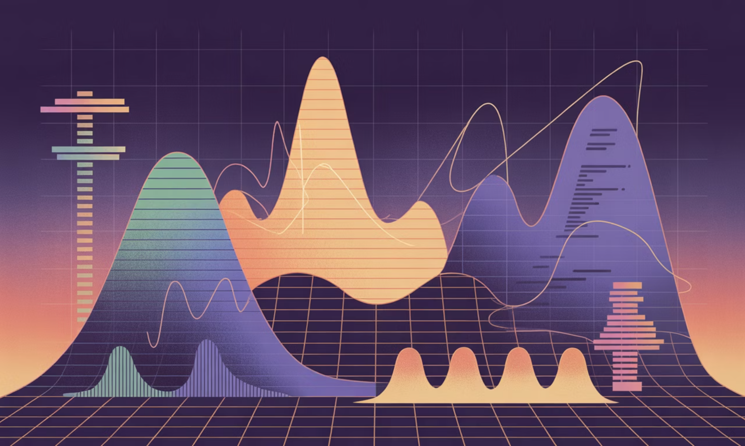
FOUNDATION
What is Music Genre Classification?
Music genre classification is the automatic categorization of audio tracks into distinct genres like rock, jazz, classical, or electronic. It's a fundamental challenge in Music Information Retrieval (MIR) that powers modern music discovery.
Key challenges: Genres often overlap and blend, labels can be subjective, and audio characteristics vary widely across recordings and production styles.

Slide 3
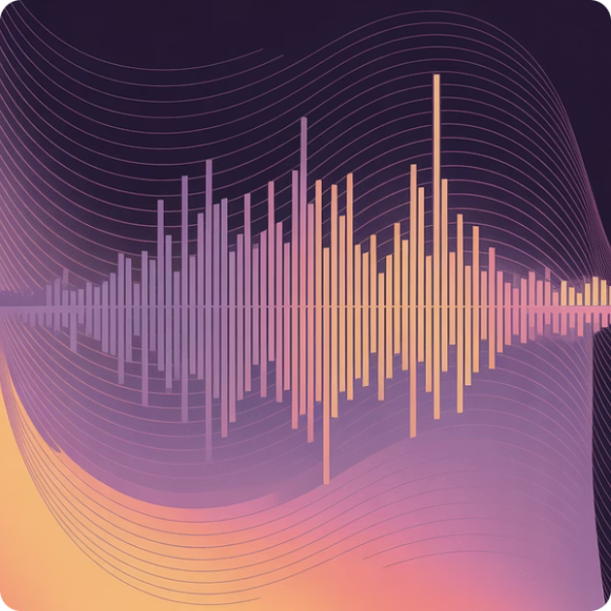


TRADITIONAL METHODS
Feature Extraction + Classical Machine Learning
Audio Feature Engineering
Classical Classifiers
Proven Performance
Algorithms like SVM, k-NN, and Random Forests learn from these engineered features to categorize music into genres.
SVMs with carefully crafted features still outperform some deep models on moderate-sized datasets, demonstrating the power of domain expertise.
Extract meaningful patterns from raw audio: MFCCs capture timbre, STFT reveals frequency content, and spectral features describe sound texture.

Slide 4

DEEP LEARNING
The Deep Learning Revolution: CNNs and Beyond
Convolutional Neural Networks Transform Audio Analysis
CNNs learn features directly from spectrograms—visual representations of audio—eliminating the need for manual feature engineering. These models see music as images and discover patterns humans might miss.
Advanced ensemble CNN architectures combine multiple feature transforms (DWT, MFCC, STFT) to achieve over 96% accuracy on benchmark datasets like GTZAN.
Hyperparameter optimization using novel algorithms like Capuchin Search fine-tunes model architecture and training parameters for peak performance.

Slide 5




Feature Engineering vs End-to-End Learning
Engineered Features
End-to-End Deep Learning
Hybrid Approaches
Provide strong domain knowledge and reduce overfitting on limited data
Requires large datasets but captures complex, subtle patterns automatically
Combine both strategies to achieve best real-world results
The future of music classification lies in intelligently combining human expertise with machine learning power

Slide 6

Real-World Applications
Streaming Platforms
Industry Intelligence
Library Management
Power playlist curation and personalized recommendations for millions of listeners discovering new music daily
Help producers and marketers understand evolving genre trends and target audience preferences effectively
Enable automatic tagging in massive digital music collections, dramatically improving search and discovery capabilities

Slide 7

RESEARCH FRONTIERS
Current Challenges & Future Directions
Mixed-Genre Complexity
Developing models that handle tracks blending multiple genres or defying traditional categories
Ambiguous Genres
Noisy Audio
Tracks blend styles, challenging clear labels.
Background noise and artifacts obscure signals.
Real-World Robustness
Building systems resilient to varying audio quality, recording conditions, and production styles
Learning Efficiency
Limited Labels
Contextual Understanding
Exploring semi-supervised and self-supervised approaches to reduce dependence on expensive labeled datasets
Scarce annotated data hinders supervised learning.
Models must infer mood, culture, and intent.
Beyond Genre
Expanding classification to mood, instrumentation, cultural context, and emotional impact
The path forward requires addressing fundamental limitations in how machines understand music

Slide 8

The Future Soundscape: AI and Music
Revolutionizing Discovery
Real-Time Intelligence
Advanced AI combines rich audio features to transform how we find and experience music
Context-aware classification running directly on devices, adapting to your environment and mood
Empowering Everyone
Smarter tools for creators and more intuitive experiences for listeners across all platforms
The journey of teaching machines to truly "hear" music like humans has just begun—and the most exciting discoveries lie ahead

